Slide 1
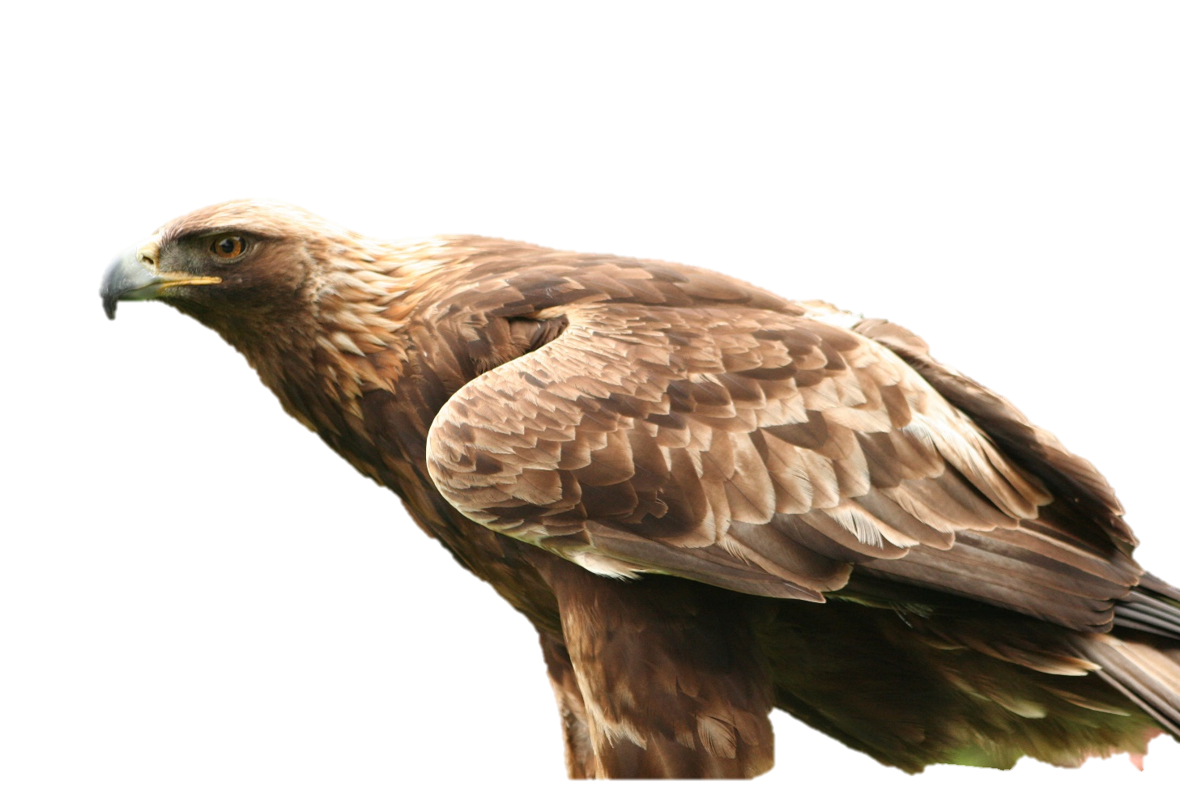
Aquila Optimizer: A novel metaheuristic optimization algorithm
Group Members:
Shivam Parashar (sp3466)
Sai Keshav Sasanapuri (ks2992)
Aakash Khatu (ak7665)
Notes:
Good Afternoon everyone,
I am Shivam and here with me is Keshav and Aakash. For the Project component of this course, we did a reproducibility study on the Aquila Optimizer: A novel metaheuristic optimization algorithm.
The optimizer takes inspiration from the hunting strategies that the aquila bird uses to catch its prey in nature.
The paper was published in 2021 and is cited by over 1300 papers as of today.

Slide 2
Problems
Optimization Challenges: Traditional mathematical optimization methods often struggle with issues like converging to local optima.
Meta-Heuristic Algorithms' Limitations: Algorithms like PSO and ACO sometimes fall short due to limitations in exploring and exploiting search spaces, leading to suboptimal solutions.
Motivation
The AO algorithm is modeled after Aquila's common hunting methods.
The optimization process of AO encompasses four strategic methods:
High Soar with Vertical Stoop: Selecting the search space.
Contour Flight with Short Glide Attack: Exploring within a divergent search space.
Low Flight with Slow Descent Attack: Exploiting within a convergent search space.
Walk and Grab Prey: Direct exploitation method for precision.
Notes:
To start with, the paper mentions few of the challenges that are currently faced which served as an inspiration for the Aquila optimizer.
Optimization Challenges
Many real-world problems in machine learning, AI, and engineering require optimal parameter settings for system design. Traditional mathematical optimization methods often struggle with issues like converging to local optima.
Meta-Heuristic Algorithms' Limitations:
Existing meta-heuristic algorithms like PSO and ACO sometimes fall short due to limitations in exploring and exploiting search spaces, leading to suboptimal solutions.

Slide 3
Related work
Swarm Intelligence Algorithms:
Particle Swarm Optimization (PSO)
Ant Colony Optimization (ACO)
Artificial Bee Colony (ABC)
Evolutionary Algorithms:
Genetic Algorithm (GA)
Differential Evolution (DE)
Biogeography-Based Optimization (BBO)
Physics-Based Algorithms:
Gravitational Search Algorithm (GSA)
Simulated Annealing (SA)
Central Force Optimization (CFO)
Notes:
Before we jump into the actual algorithm, let’s look at few of the related work in the field.
Swarm Intelligence Algorithms:
Particle Swarm Optimization (PSO): Models the social behavior of birds flocking or fish schooling to find optimal solutions.
Ant Colony Optimization (ACO): Mimics how ants deposit pheromones to mark optimal paths to food sources.
Artificial Bee Colony (ABC): Simulates honey bees' search for nectar, balancing exploration and exploitation.
Evolutionary Algorithms:
Genetic Algorithm (GA): Uses principles of natural selection and genetic evolution, like crossover and mutation, to improve solution populations.
Differential Evolution (DE): Generates new solutions by adding weighted differences between solutions, simulating natural variations.
Biogeography-Based Optimization (BBO): Inspired by the migration patterns of species and their geographical distribution.
Physics-Based Algorithms:
Gravitational Search Algorithm (GSA): Models interactions based on gravitational laws, treating solutions as masses that attract each other.
Simulated Annealing (SA): Simulates the physical annealing process, cooling gradually to find a global minimum.
Central Force Optimization (CFO): Mimics gravitational kinematics by moving solutions toward an optimal central point.

Slide 4
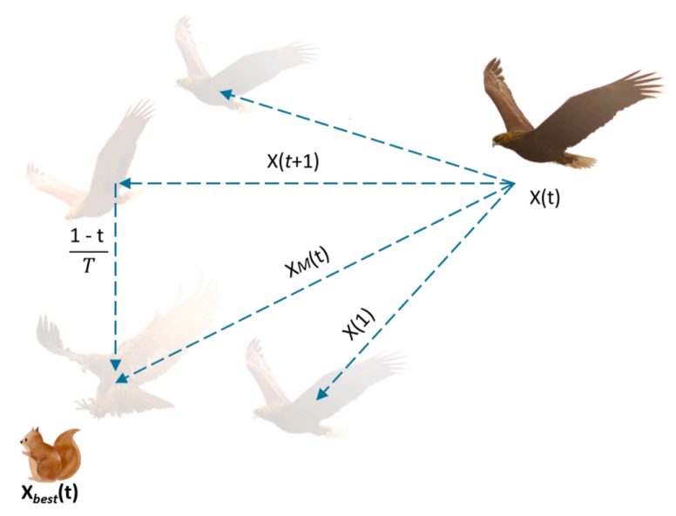
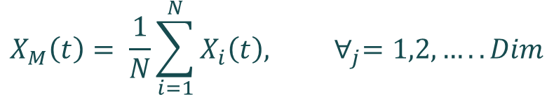
Phase 1: Expanded Exploration
$$X_{1}\left(t+1\right)=X_{best}\left(t\right) × \left(1−\frac{t}{T}\right)+(X_{M}\left(t\right)−X_{best}\left(t\right)∗rand)$$
[0,1]
Finest solution found so far
Controls exploration
Mean value of current solutions
$$X_{M}\left(t\right)= \frac{1}{N}\sum_{i=1}^{N}{X_{i}\left(t\right), ∀_{j}=1,2,…..Dim}$$
Population size
Notes:
Phase 1 is expanded exploitation, which covers the initial hunting strategy where aquila soars high to get a broad view of the landscape. It helps in identifying potential prey or solutions from a distance.

Slide 5
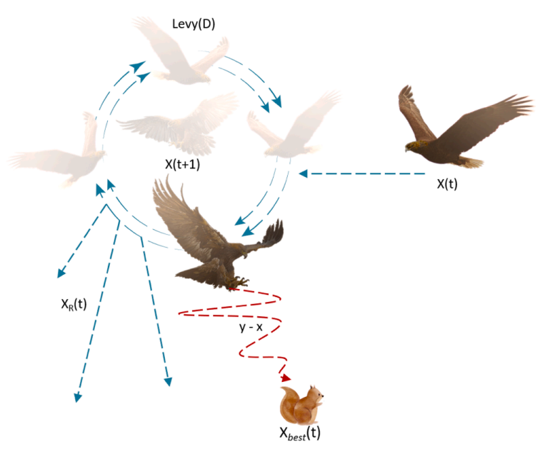
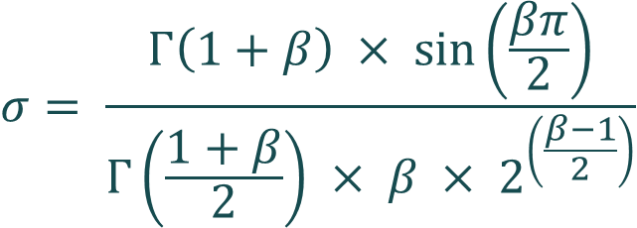
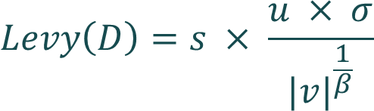
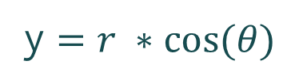
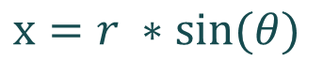
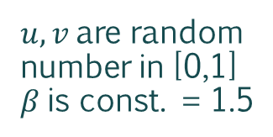
Phase 2: Narrowed Exploration
$$X_{2}\left(t+1\right)=X_{best}\left(t\right) × Levy\left(D\right)+(X_{R}\left(t\right)+\left(y−x\right)∗rand)$$
Finest solution found so far
Random solution belonging to any agent in [1,N]
Levy Flight distribution
$$Levy\left(D\right)=s × \frac{u × σ}{{|v|}^{\frac{1}{β}}}$$
$u,v$are random number in [0,1]
$β$is const. = 1.5
constant value = 0.5
$$σ= \frac{Γ\left(1+β\right) × \sin\left(\frac{βπ}{2}\right)}{Γ\left(\frac{1+β}{2}\right) × β × 2^{\left(\frac{β−1}{2}\right)}}$$
y $=r ∗\cos{(θ})$
presents spiral shape in search
$$x=r ∗\sin{(θ})$$
Notes:
This is followed by the phase 2 which is Narrowed Exploration. In this phase, Aquila circles above the target prey or solution and prepares to land.

Slide 6
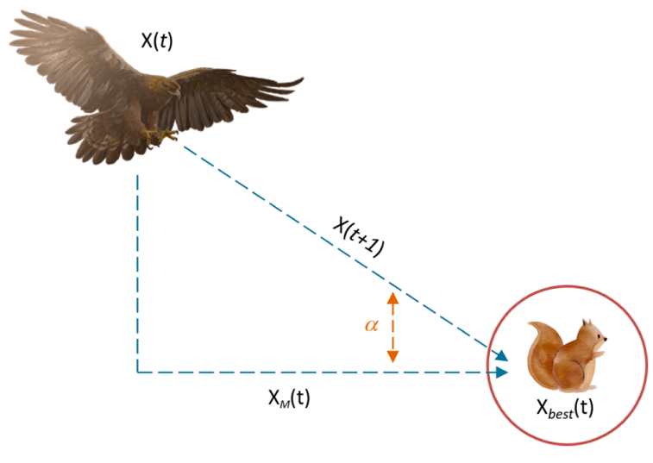
Phase 3: Expanded Exploitation
$$X_{3}\left(t+1\right)=(X_{best}\left(t\right) × \left(X_{M}\left(t\right)\right)× α−rand+((UB −LB)× rand+LB)×δ$$
Finest solution found so far
Upper Bound
Lower Bound
Mean value of current solutions
α and δ denotes fixed exploitation adjustment parameters.
α = 0.1 and δ = 0.1
Notes:
So, the first two phases focuses on the exploration and once we have completed 2/3rd of the iteration algorithm transitions into exploitation.
In phase 3, we start with the expanded exploitation which involves intensive search in a localized area for optimal solutions.

Slide 7
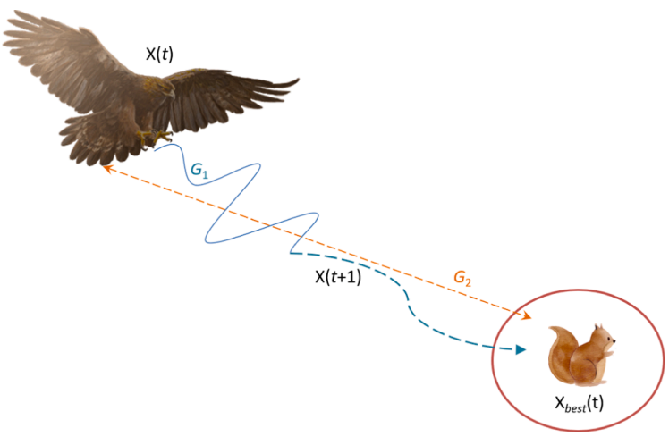
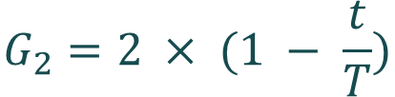
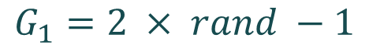
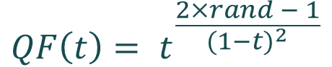
Phase 4: Narrowed Exploitation
$$X_{4}\left(t+1\right)=QF × X_{best}\left(t\right)−\left(G_{1} × X\left(t\right) × rand\right)−(G_{2} × Levy\left(D\right) +rand × G_{1})$$
$$G_{2}=2 × (1 − \frac{t}{T})$$
$$QF\left(t\right)= t^{\frac{2×rand − 1}{{(1−t)}^{2}}}$$
Flight slope
Quality Function
$$G_{1}=2 × rand −1$$
Various motions
Notes:
Finally, we come to phase 4 which is Narrowed exploitation. This phase ensures the fine-tuning of solutions to reach the global optimum.

Slide 8
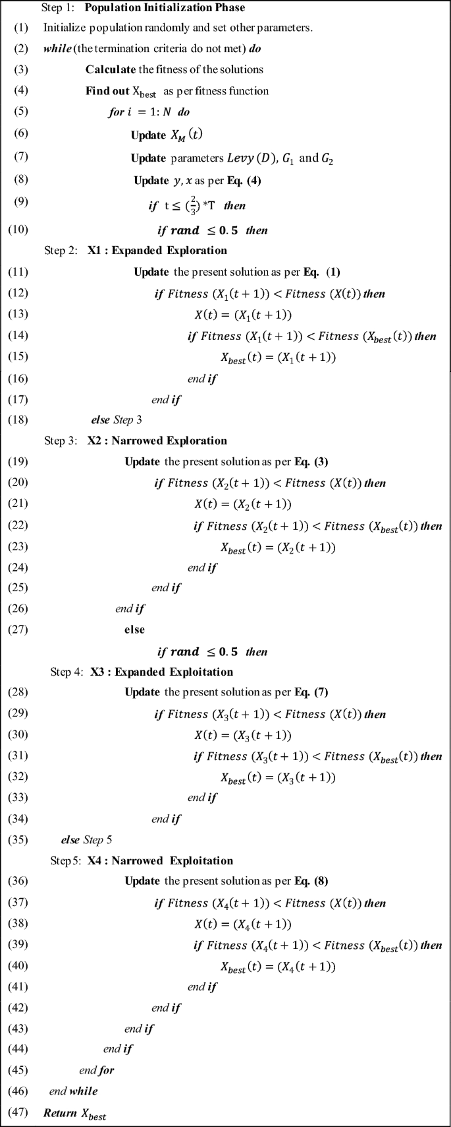
Pseudocode and hyperparameters
Max_iter = 100 pop_size = 30 G2 = 2 * np.random.rand() - 1 G1 = 2 * (1 - t / T) to = np.arange(1, Dim + 1) u = 0.0265 r0 = 10 r = r0 + u * to omega = 0.005 phi0 = 3 * np.pi / 2 phi= -omega * to + phi0 x = r * np.sin(phi) y = r * np.cos(phi) beta = 1.5 s = 0.5 alpha = 0.1 delta = 0.1

Slide 9





Algorithm
Start
Initialize parameters and population of the AO optimizer
Set current iteration t=1
$$t=t+1$$
Calculate fitness of each member in the population and determine its best
If $t<\frac{2}{3}T$
If $rand≤0.5$
If $rand≤0.5$
Update current solution using Eq. (1)
Update current solution using Eq. (2)
Update current solution using Eq. (3)
Update current solution using Eq. (4)
Save best solution
If $t=T$

Slide 10
Experimental design
For evaluating the performance of the optimizer, we used the following benchmark functions.
29 Benchmark Functions from CEC 2017
9 Benchmark Functions from CEC 2019
23 Classical Benchmark Functions
For all the Above algorithms we recorded the following observations:
Mean
Best in all the Trials
Worst in all the Trials
Standard Deviation
Convergence graphs

Slide 11
Comparative Algorithms:
Grasshopper Optimization Algorithm (GOA) (Abualigah & Diabat, 2020)
Equilibrium Optimizer (EO) (Faramarzi, Heidarinejad, Stephens, & Mirjalili, 2020),
Particle Swarm Optimization (PSO) (Abualigah, Khader, & Hanandeh, 2018),
Ant Lion Optimizer (ALO) (Abualigah, Shehab, Alshinwan, Mirjalili, et al., 2020),
Grey Wolf Optimizer (GWO) (Abualigah, Shehab, Alshinwan, Alabool, et al.,2020),
Marine Predators Algorithm (MPA) (Al-Qaness, Abualigah, & Abd Elaziz, 2020),
Salp Swarm Algorithm (SSA) (Abualigah et al., 2019),
Sine Cosine Algorithm (SCA) (Mirjalili, 2016),
Whale Optimization Algorithm (WOA) (Mirjalili & Lewis, 2016),
Slime Mold Algorithm (SMA) (Zhao, Gao, & Sun, 2020)

Slide 12
Tests Conducted
Each Test Conducted has the following parameters:
100 Max Iterations for the Classical test functions or 200 Iterations for the CEC test functions.
Population size of 30
30 Trials
In total we had to conduct 1081 tests, across 11 optimization algorithms and 61 Benchmark functions at various dimensionalities.
All the tests took a total of 10 hours to run parallelly.

Slide 13
Classical Benchmark Functions : Unimodal
Notes:
Unimodal is exploitation multimodal is exploration exploration in low dimensions

Slide 14
Classical Benchmark Functions : Unimodal
Notes:
Unimodal is exploitation multimodal is exploration exploration in low dimensions

Slide 15
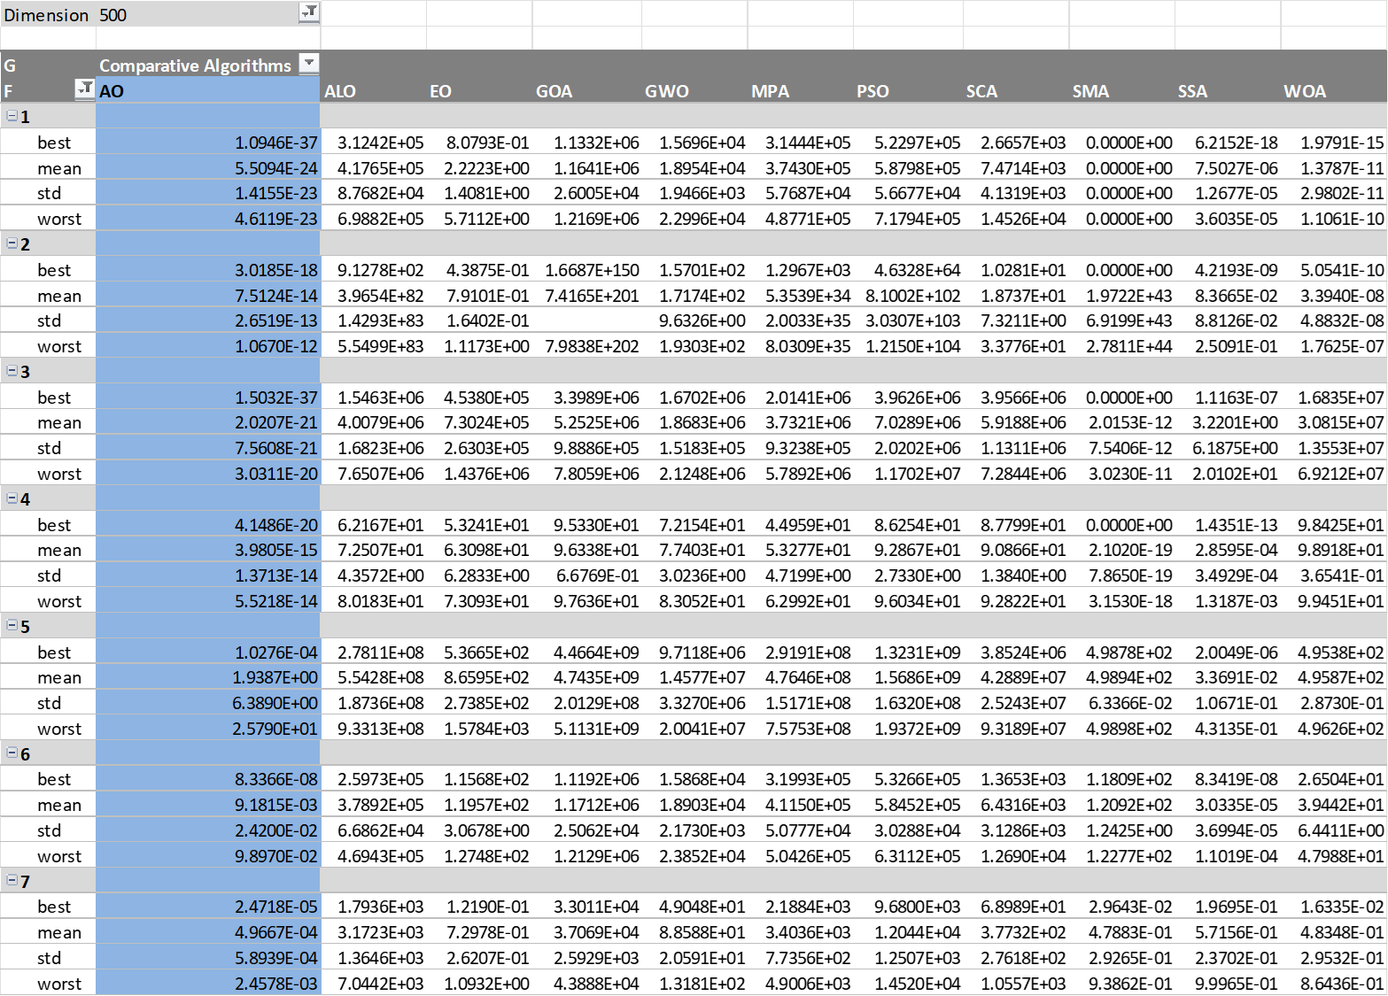
Classical Benchmark Functions : Unimodal
Notes:
Unimodal is exploitation multimodal is exploration exploration in low dimensions

Slide 16
Classical Benchmark Functions : Multimodal
Notes:
Unimodal is exploitation multimodal is exploration exploration in low dimensions

Slide 17
Classical Benchmark Functions : Multimodal
Notes:
Unimodal is exploitation multimodal is exploration exploration in low dimensions

Slide 18
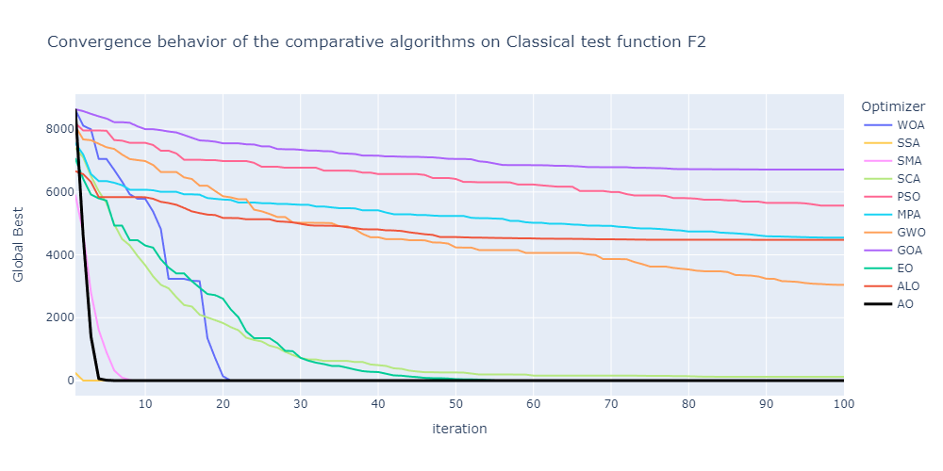
Convergence Analysis

Slide 19
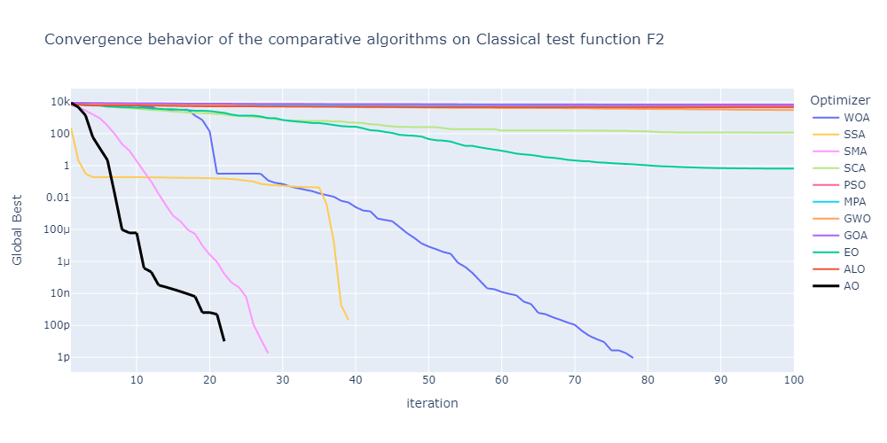
Convergence Analysis

Slide 20
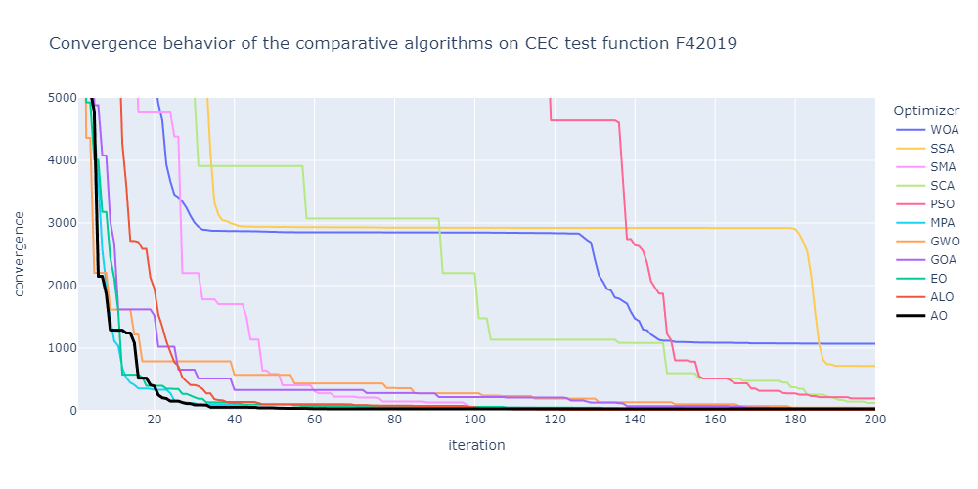
Convergence Analysis

Slide 21
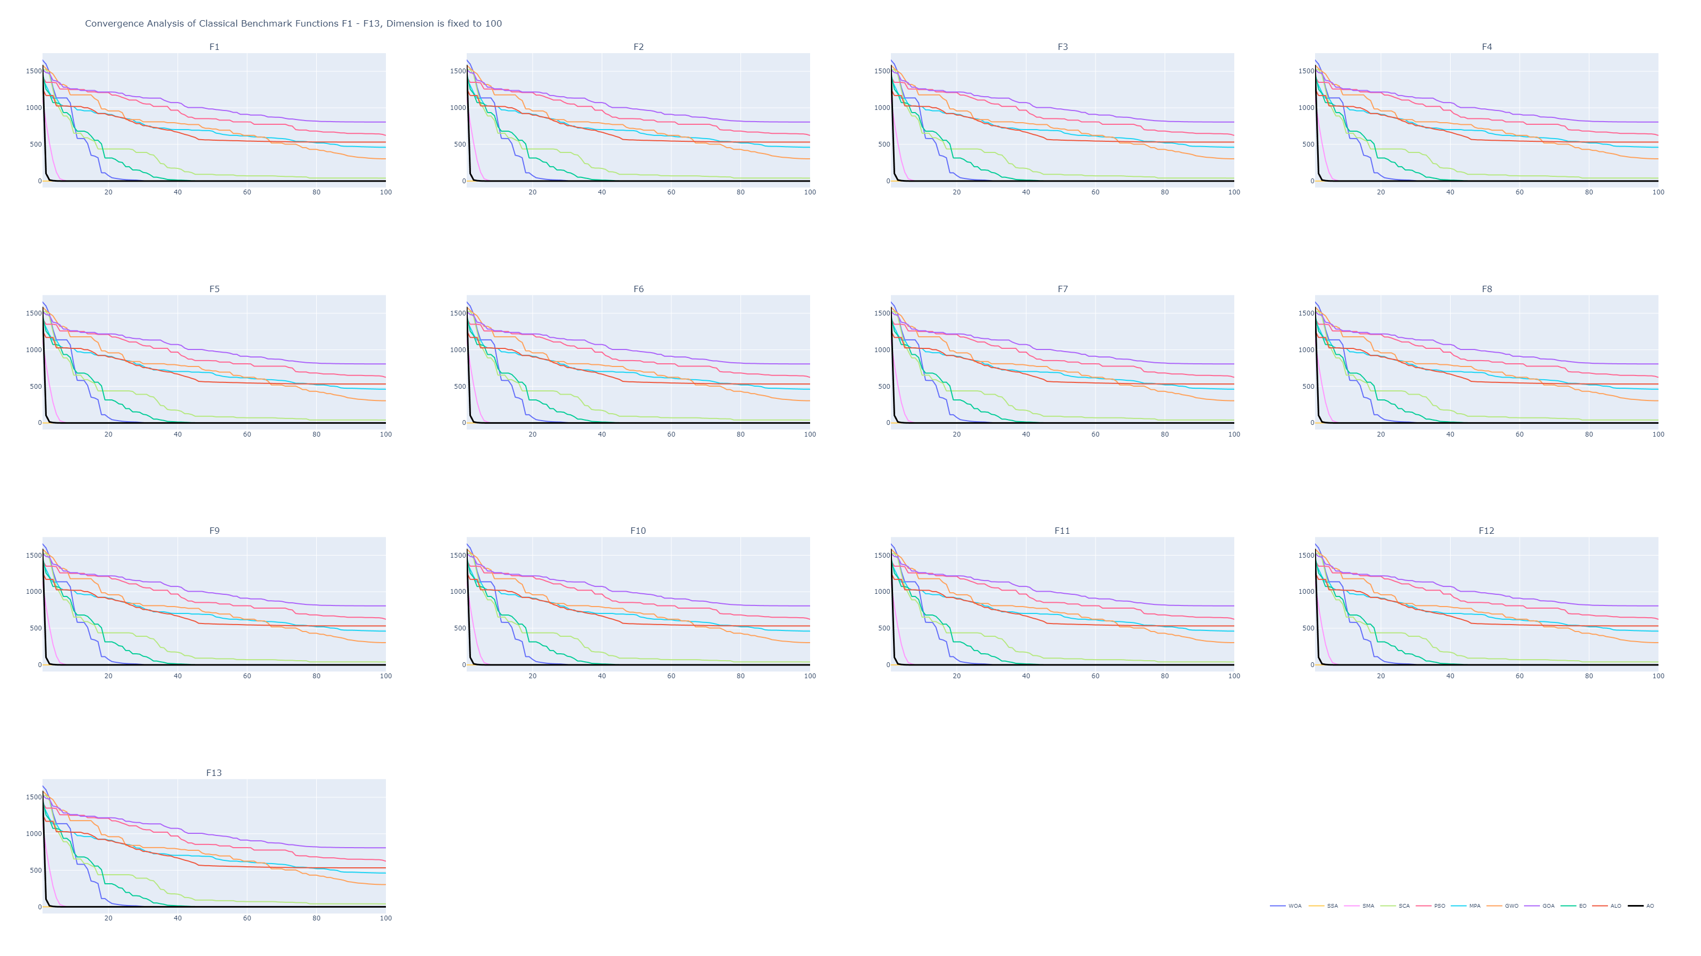

Slide 22
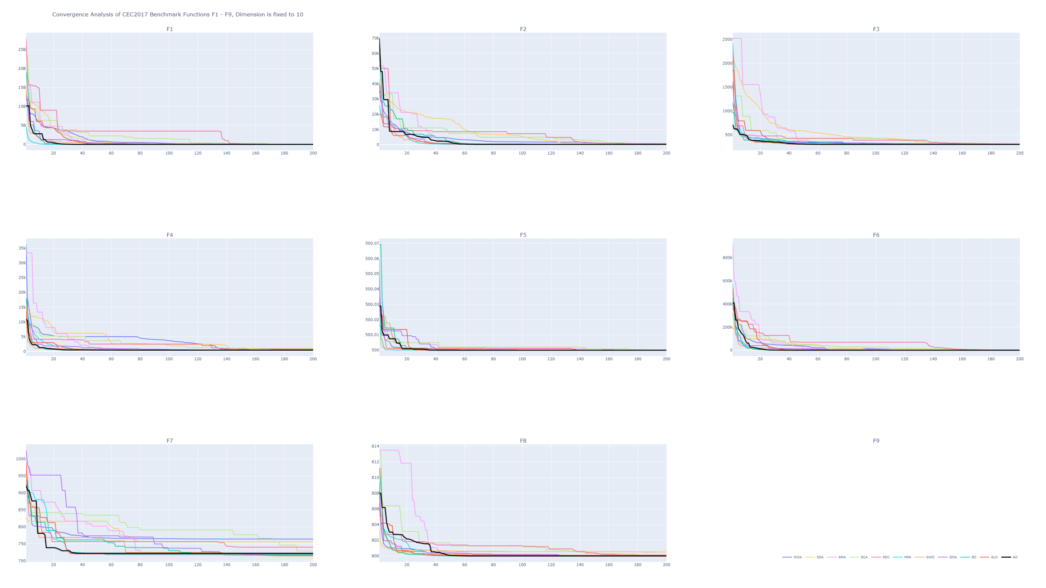

Slide 23
Insights
We found out that even though AO is Great, it is not always as good as the outcomes in the original paper when compared to the other algorithms.
In our tests AO performed perfectly as show in the Original paper but the other algorithms seemed to perform better than shown in the original paper.
This could be because of our chosen Implementation of the comparative algorithms being different than the original paper as it doesn’t talk in detail about the other algorithms.

Slide 24
References
Laith Abualigah, Dalia Yousri, Mohamed Abd Elaziz, Ahmed A. Ewees, Mohammed A.A. Al-qaness, Amir H. Gandomi,
Aquila Optimizer: A novel meta-heuristic optimization algorithm,
Computers & Industrial Engineering,Volume 157,2021,107250,ISSN 0360-8352, https://doi.org/10.1016/j.cie.2021.107250 .(https://www.sciencedirect.com/science/article/pii/S0360835221001546)

Slide 25
References
Nguyen Van Thieu, Seyedali Mirjalili, MEALPY: An open-source library for latest meta-heuristic algorithms in Python
Journal of Systems Architecture, Volume 139, 2023, 102871,ISSN 1383-7621, https://doi.org/10.1016/j.sysarc.2023.102871. (https://www.sciencedirect.com/science/article/pii/S1383762123000504)
Nguyen Van Thieu, Opfunu: An Open-source Python Library for Optimization Benchmark Functions, Zenodo, 2020, https://doi.org/10.5281/zenodo.3620960.(https://pypi.org/project/opfunu/)
https://link.springer.com/article/10.1007/s11831-023-09945-6#:~:text=The%20classical%20Aquila%20Optimizer%20(AO,Expanded%20Exploitation%20and%20Narrowed%20Exploitation.

Slide 26
Thank You!

